Slide 1
By F. Ghavipanjeh fghavipanjeh@gmail.com

Slide 2
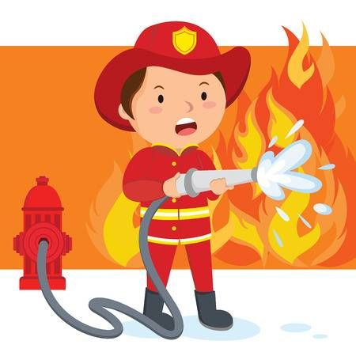
firefighter

Slide 3
dentist

Slide 4
driver

Slide 5
farmer

Slide 6
policeman

